Slide 1
University of Mindanao e-scooter through online payment
Presented by: Jerfel Francis A. Maamo

Slide 2

Business Logo & Name
Business Name: UM E-Scooter Rental
The name highlights the focus on providing electric scooter rentals for the University of Mindanao community, making it clear, relevant, and easily recognizable.
Business Logo:
The logo features an electric scooter and eco-friendly elements, emphasizing fast, sustainable transport while incorporating UM’s colors to connect with the university identity.

Slide 3
Business description
UM E-Scooter Rental is an innovative transportation service providing students, faculty, and visitors with a convenient, eco-friendly way to navigate the University of Mindanao campus.
The service helps reduce commuting time, promotes sustainability, and enhances campus mobility.

Slide 4
Product description
E-Scooters: On-demand electric scooter rental service designed for the campus community.
Benefits:
Fast Commutes: Reduces travel time across campus.
Convenience: On-demand availability at key campus locations.
Sustainability: Environmentally friendly transportation with zero emissions.
Affordability: Cost-effective, pay-per-minute pricing.

Slide 5
Total Variable Cost( 10 Units )
Cost Item | Cost per Month (PHP) per Scooter | Quantity | Monthly Cost (PHP) | Annual Cost (PHP)
Mechanic | 900 | 10 | 9,000 | 108,000
Charging Costs | 700 | 10 | 7,000 | 84,000
Fleet Maintenance | 1,250 | 10 | 12,500 | 150,000
Total |  |  | 28,500 | 342,000

Slide 6
Price per Unit
Description | Calculation | Amount (PHP)
Monthly Costs | Operational cost + Variable Costs | 131,300 + 28,500
 |  | 159,800
Total Rides per month | Total rides per day * 30days | 150 * 30
 |  | 4,500
Total Ride time per month | Ride time * Total Rides per month | 4,500 * 30
 |  | 135,000 minutes
Cost per Minute | Total Monthly Costs / Total Ride Time | 159,800/135,000
 |  | 1.18/Minute
Final Price per minute | Cost per Minute * Mark-up | 1.18 * 1.6
 |  | 1.89/minute

Slide 7
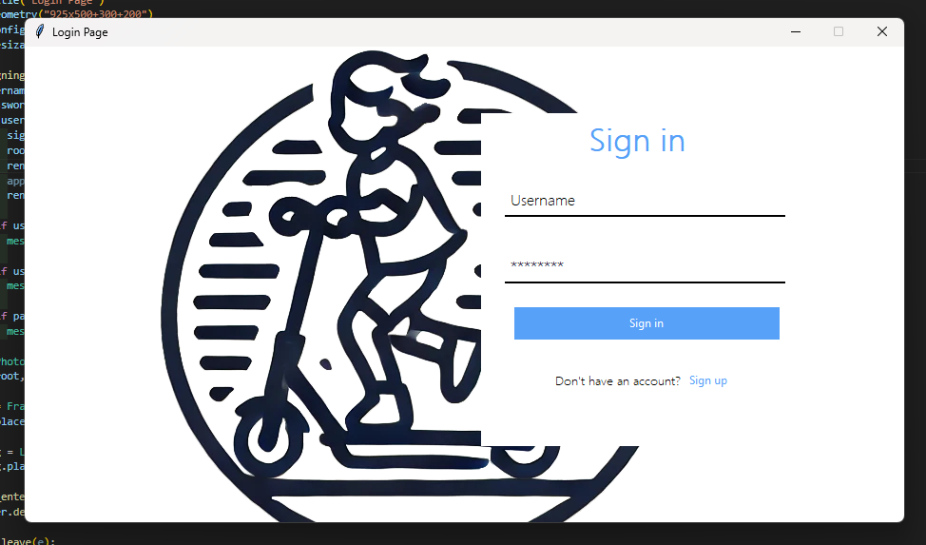
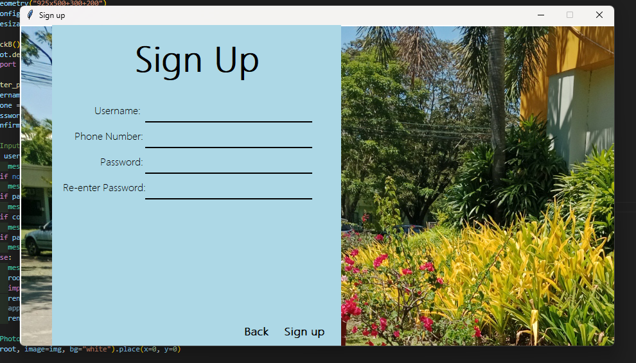
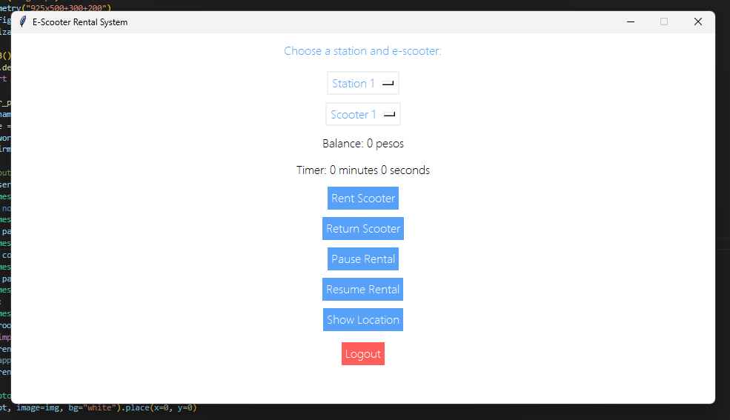
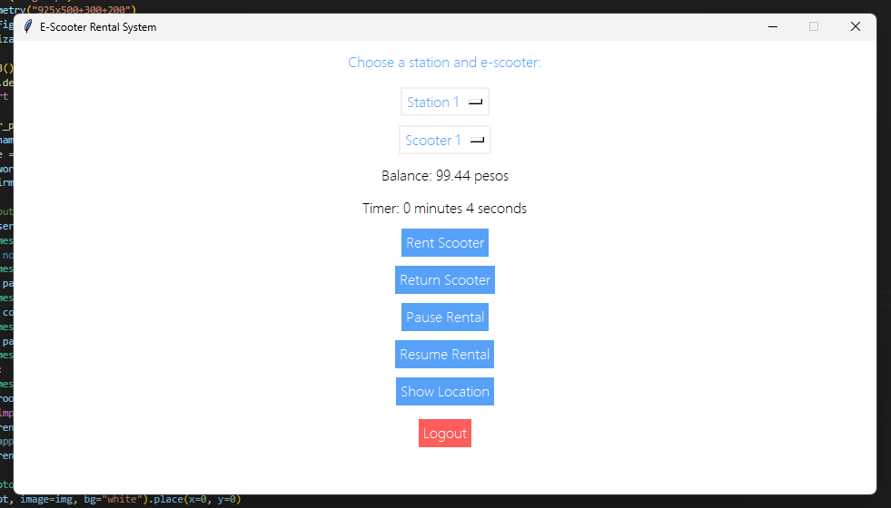
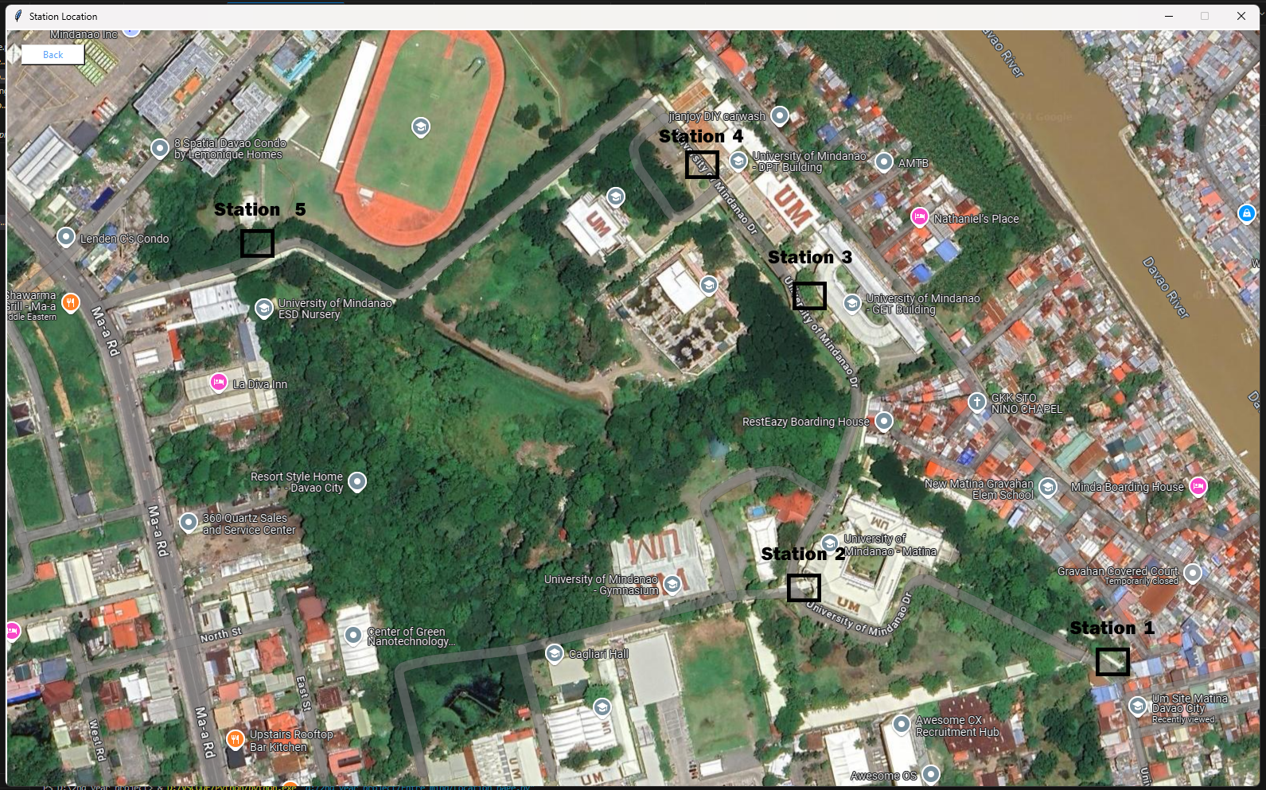
Product Prototype

Slide 8
Market Aspect
Pricing Strategy
Base Price: PHP 55 per 30 minutes, offering cost-effective travel for students and faculty.
Hourly Rate: PHP 110 per hour, providing significant savings compared to traditional transport.
Discount/Promos
Promotional Offers:
First Ride for PHP 10 to attract new users.
Rent 1 Hour, Get 15 Minutes Free for longer usage.
Seasonal Pricing Adjustments:
Introduce discounts during off-peak seasons (e.g., holidays).
Surge pricing (1.2x to 1.5x) during peak periods, such as exam weeks or major campus events.

Slide 9
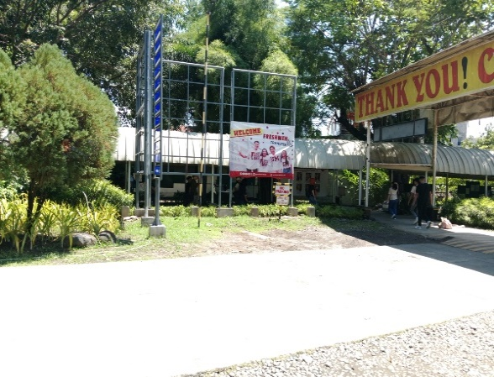
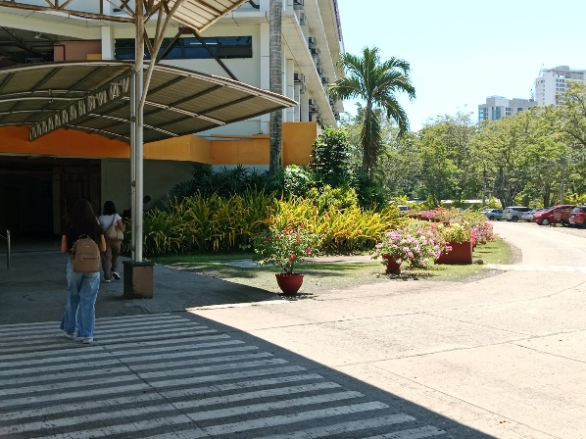
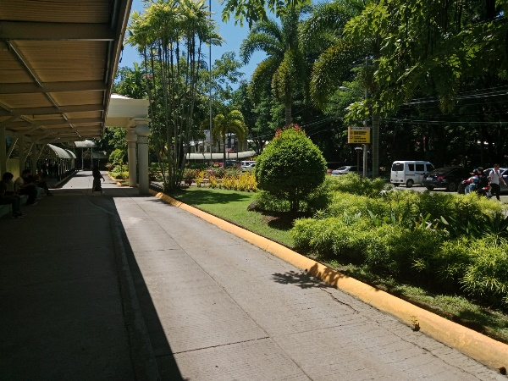
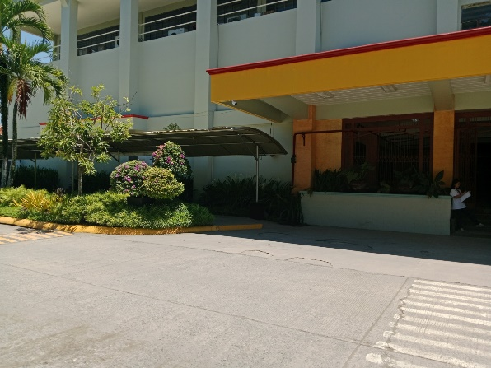
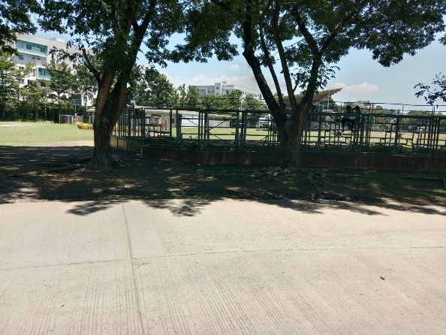
Place
Station 1 | Station 2 | Station 3 | Station 4 | Station 5

Slide 10
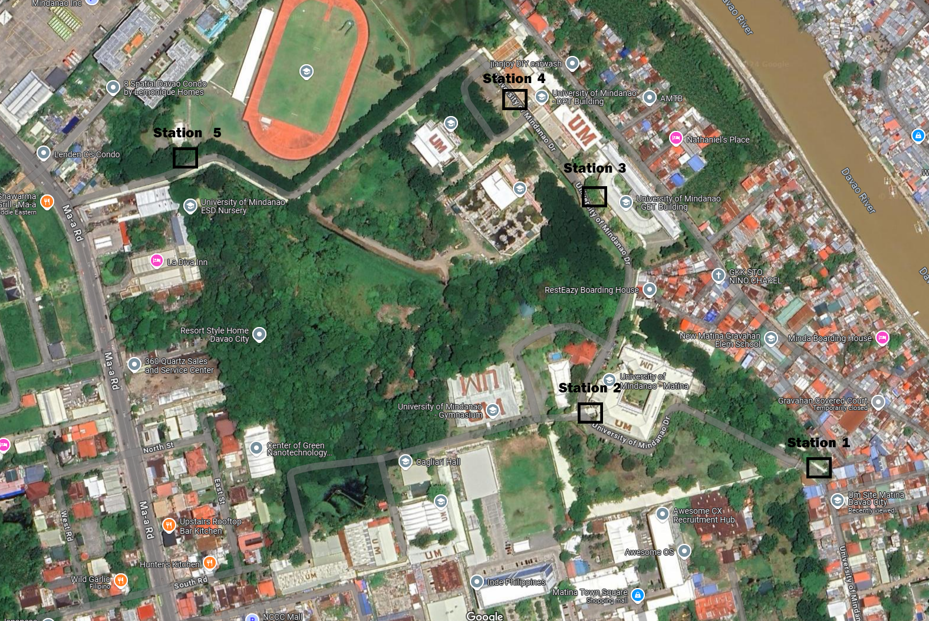

Slide 11
Promotion
Social Media Engagement
Hashtag: #ScootFast
Encourage users to share experiences online for rewards.
Easy-to-Use App
Tagline: “Rent with a Tap”
Show how simple the app is for rentals and payments
Eco-Friendly Solution
Tagline: “Ride Green, Save the Planet”
Promote sustainability and lower carbon footprint.

Slide 12
Total Start-up Cost
Item | Amount (PHP) | Quantity | Total (PHP)
E-Scooter Fleet | 36,000 | 10 | 360000
Charging Station | 36,000 | 5 | 180000
GPS Devices | 3700 | 10 | 37,000
Maintenance Tools | 10,200 | 10 | 102,000
IT Infrastructure | 88,000 | 1 | 88,000
License and Permit | 2,000 | 10 | 20,000
Insurance | 2,500 | 10 | 25,000
Branding and Marketing | 100,000 | 1 | 100,000
Total Start-Up Costs |  |  | 910,000

Slide 13
Total Production and Operation Cost
Item | Cost (PHP/Month) | Annual Amount (PHP)
Mechanic | 9,000 | 108,000
Electrician | 6,000 | 72,000
Fleet Maintenance | 12,500 | 150,000
Charging Stations | 8,500 | 102,000
Charging Costs | 7,000 | 84,000
Staff Costs (Technicians) | 49,100 | 589,200
IT Insurance and Support | 5,500 | 66,000
GPS | 3,700 | 44,400
Software/Platform Subscription | 11,000 | 132,000
Miscellaneous (Marketing) | 20,000 | 240,000
Total Monthly Costs | 131,300 | 1,575,600

Slide 14
Projected Income (One Year Operation)
Profit Calculation:
Monthly Revenue = Total Ride Time per Month * Time per Minute
135,000 Minutes * PHP 1.89 = PHP 255,150
Annual Revenue = Monthly Revenue * Months in a year
PHP 255,150 * 12 months = 3,061,800
Annual Operational Costs = Total Monthly Costs * Months in a year
159,800 * 12 months = 1,917,600
Projected Annual Profit = Annual Revenue – Annual Costs
3,061,800 – 1,917,600 = 1,144,200

